Slide 1
Light
pat.ryan61@gmail.com

Slide 2
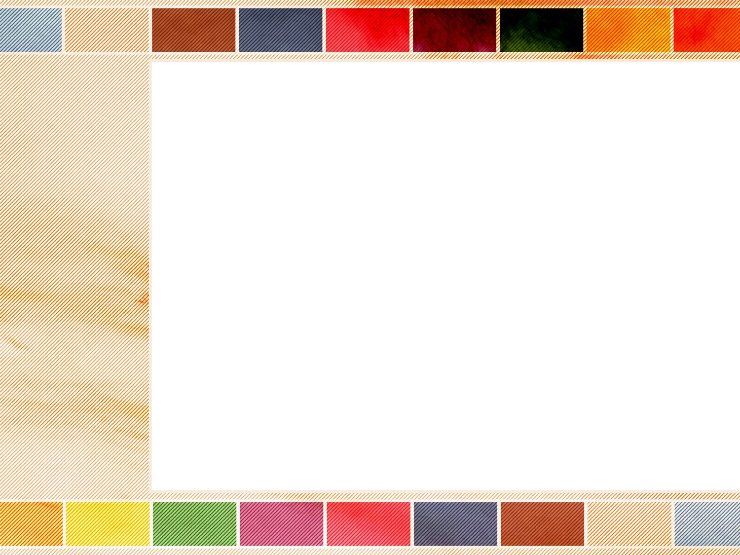
Light is a form of energy that comes from the sun.
The sun is the main source of light on the earth.
The sun gives off light that travels to our eyes.
Light from the sun reflects off objects.
Light from the objects enters our eyes.

Slide 3
The moon does not produce light.
The light from the sun is reflected off the moon.
The stars in the sky are like the sun.
They are so far away that they appear small.
Light from these stars is very weak.
The light takes a long time to reach us.

Slide 4
The sun is very large and very far away.
Light from the sun travels to earth.
The light causes a shadow when it hits something.
The shadow has the same shape as the object.
It might appear longer of shorter.

Slide 5
When the sun is overhead, shadows are short.
When the sun is low in the sky, shadows are long.
If an object is close to its shadow, the shadow is dark.
If the object is farther away, the shadow is lighter.

Slide 6
We can make light with fire.
The light from fire is like the light from the sun.
Burning candles give off light.
Lightning in a thunderstorm also produces light.
If lightning strikes the ground it can cause fires.

Slide 7
Small sparks similar to lightning happen when two objects made of different material rub together.
These sparks can be made by our clothes.
We can produce them with a plastic ruler and a cloth.
We can see these sparks better when it is dark.

Slide 8
Most of the objects in the world have colour.
The clouds are often white.
The sky appears blue, and water often looks blue.
The trees usually have green needles or leaves.
The flames of a fire may look yellow, orange or red.

Slide 9
Fruit can be red or blue or purple.
We see different colours in the objects around us.
We see colours because of the light that reflects off an object.
Light is white.
When there is no light everything that we see looks black.

Slide 10
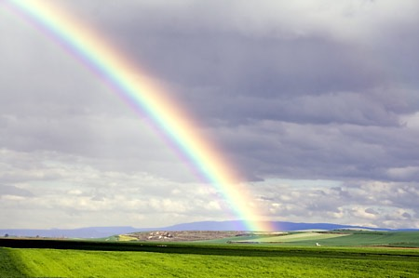
Sunlight can appear as a rainbow.
The light passes through water droplets in the sky.
The rainbow is shaped like part of a circle.
The rainbow has many different colours.

Slide 11

The Rainbow Colours

Slide 12

The Light Spectrum

Slide 13
All rainbows contain the same basic colours.
They are red, orange, yellow, green, blue, indigo and violet.
The primary colours are red, yellow and blue.
The other colours can be made by mixing these.

Slide 14
Orange comes from red and yellow.
Green is from yellow and blue.
Violet is a mixture of red and blue.
Many different colours can be made using these three primary colours.
Mixing the three primary colours produces black.

Slide 15
Red
Yellow
Blue
The Primary Colours

Slide 16
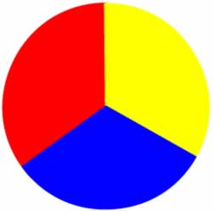
The Primary Colours

Slide 17
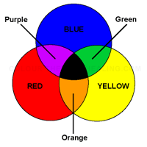

Slide 18
Light may be reflected off a surface.
Water can reflect light back to us.
We see an image of the object.
Mirrors reflect an exact image.
Looking at the mirror at an angle, we see objects that are behind us.
Mirrors can be used to see around corners.

Slide 19
Object reflects back in a straight line
Object reflects back at an angle

Slide 20
The stick in the empty glass is straight.
The stick in the water appears to be bent.

Slide 21

The drops of water on the penny change the appearance of the penny.

Slide 22
The penny in the jar of water can be seen at a different angle than the penny in the empty jar.

Slide 23
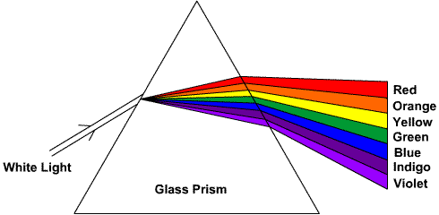
The light that enter the prism changes colour.

Slide 24
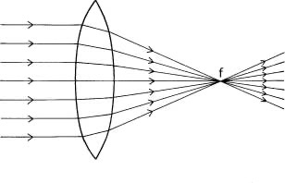
The light that enter the double convex lens can be focused and concentrated to be stronger.

Slide 25
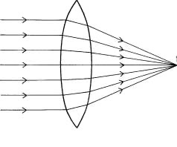
The object that is observed using a double convex lens appears larger.

Slide 26
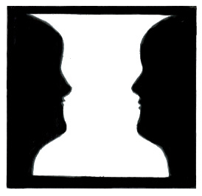

Slide 27
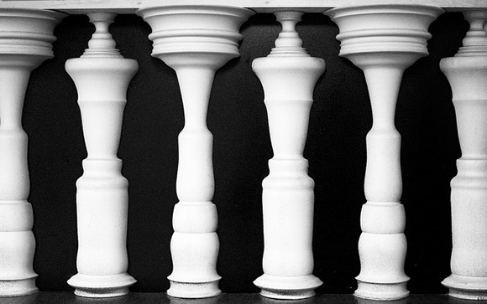

Slide 28
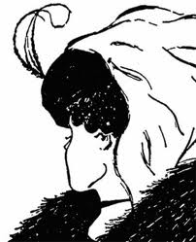

Slide 29
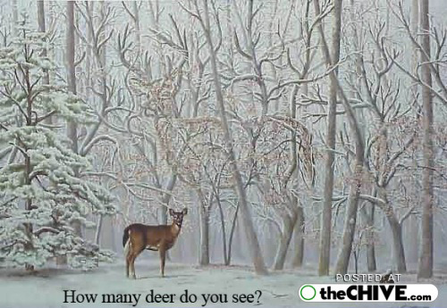

Slide 30
