Slide 1
Kindergarten
Learning while playing

Slide 3
The program has a threefold mandate:
To serve as a rite of passage that gives children a liking for school
To foster children's overall development
To prepare the groundwork for their future schooling
All through play!

Slide 4
The program focuses on the development of the whole child. Six closely linked competencies are targeted:
To perform sensorimotor actions (fine and gross motor skills)
To affirm his/her personality
To interact harmoniously with others
To communicate using the resources of language
To construct his/her understanding of the world
To complete an activity or project

Slide 5
To perform sensorimotor actions (fine and gross motor skills)
This competency is developed in motor and sensory play, art activities and activities outside the classroom or school (gym, park, school yard).
Examples of activities of fine motor skill activities:

Slide 6
To perform sensorimotor actions (fine and gross motor skills)
Examples of activities of fine motor skill activities:

Slide 7
To affirm his/her personality
This competency is developed through the children’s everyday experience in play, projects, creative activities and relations with others. This competency contributes to children’s emotional development by building self-esteem. Through a variety of experiences, children learn to see themselves as unique individuals with their own tastes, interests and needs.

Slide 8
To interact harmoniously with others
This competency is developed in everyday classroom life through play and projects.

Slide 9
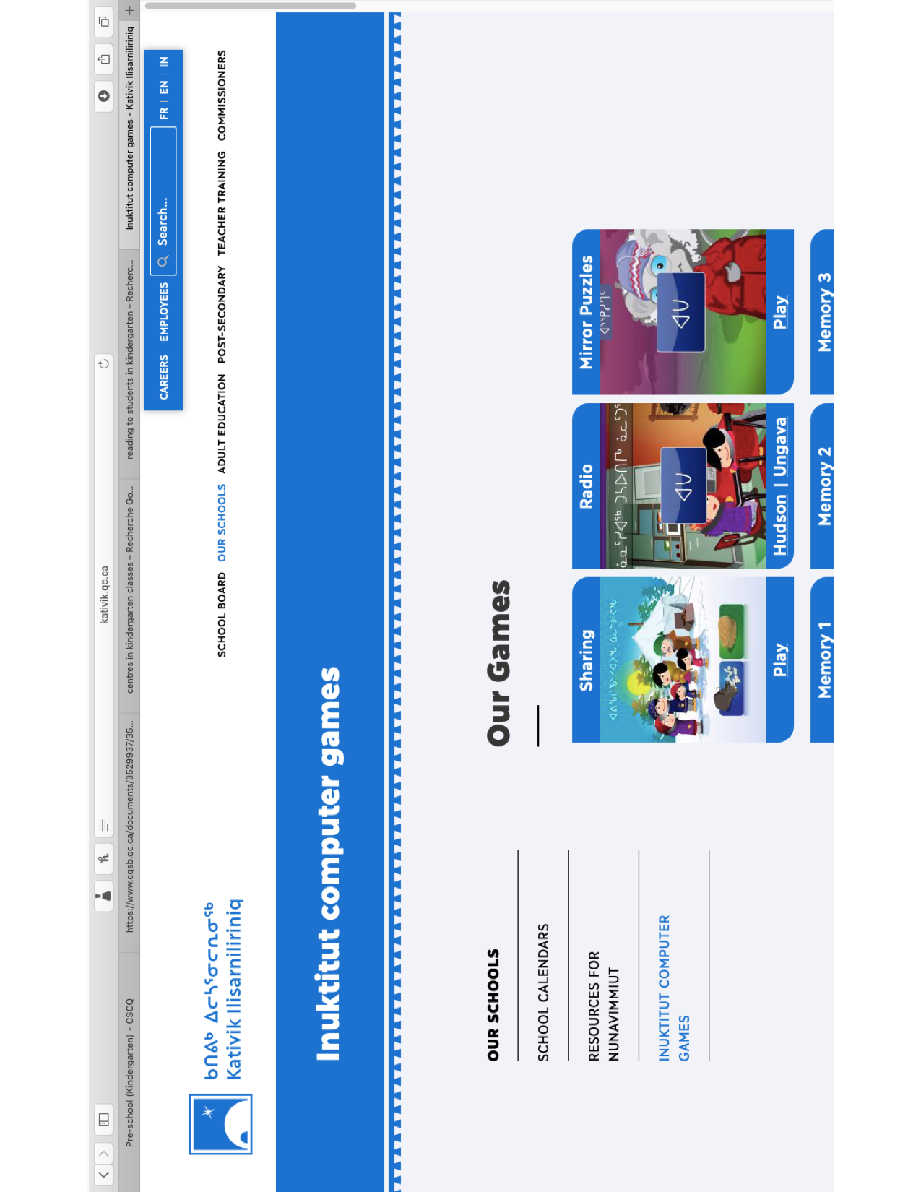
To communicate using the resources of language
This competency is directly connected to the communication-related competency “To communicate appropriately.”

Slide 10
To construct his/her understanding of the world
This competency is related to the four intellectual competencies, “To use information,” “To exercise critical judgment,” “To use creativity” and “To solve problems.”

Slide 11
To complete an activity or project
Children develop this competency by exploring their physical, human and cultural environment, and through work in the different subject areas. This competency involves the development of work methods.

Slide 12
Learning while
Playing

